Slide 1

Citi HackOverflow
Team FizzBuzz

Slide 2

“
By combining our Private Bank and
consumer wealth businesses…
… target clients in themiddle of the
wealth continuum, which to date has
been largely untapped for us
”
Jane Fraser
Letter to Shareholders, Citi Annual Report 2021
HackOverFlow 2022

Slide 3

Table of Contents
03
04
Our Proposal
Our Potential
01
Our Team
02
The Problem
05
Our Product
HackOverFlow 2022

Slide 4

Our
Team
01
HackOverFlow 2022

Slide 5

The
Problem
02
HackOverFlow 2022

Slide 6

6.7% rise in average
wealth per capita in
Asia-Pacific in 2020
Global Wealth Report 2021
Credit Suisse
Region’s average
financial literacy
score is 34 of 100
Journal of Banking
and Finance
HackOverFlow 2022

Slide 7

The Problem
Lack of educational resources for financial literacy
which are recognised by financial institutions
Rise in self-directed investing while institutional wealth
management products involve F2F interaction
Absence of digital engagement to funnel customers into
Citi Wealth Management
Target Audience
First Generation wealth builders in Asia who have
limited financial literacy due to a lack of generational
asset adoption & experience in markets
HackOverFlow 2022

Slide 8

Our
Proposal
03
HackOverFlow 2022

Slide 9

Tiered Wealth Products
Long-term Wealth
Builders
3
1
Educating & Self
Supported Investing
Bankers provide personalised
services and regular updates
to clients on high-risk, long-
term wealth positions
Clients can take up
accredited courses to make
wiser financial choices in
2
medium-risk wealth products
Self-Directed Investing
Asynchronous support from
Citi Wealth RMs
Bankers can offer an end-to-
end automated positioning on
certain low-risk wealth
products
Citi Wealth Management
Product Offering
HackOverFlow 2022

Slide 10

SimpliCiti
Developing a unique
gamified portfolio builder to
introduce wealth
management
Storyline-based flow
with users making simple
investment choices and
observing outcomes
HackOverFlow 2022

Slide 11
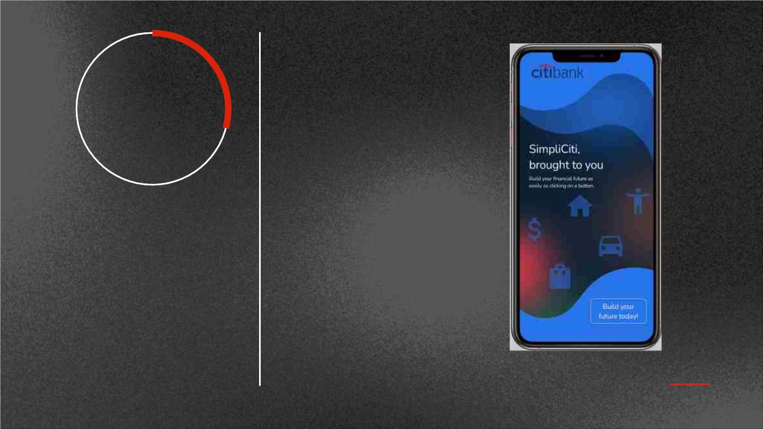
SimpliCiti
Developing a unique
gamified portfolio builder to
introduce wealth
management
Storyline-based flow
with users making simple
investment choices and
observing outcomes
HackOverFlow 2022

Slide 12

Citi
Sandbox
Citi Academy
Learning Management
System with courses
developed by Citi
Virtual Investing Sandbox
to build up portfolio models
built on a freemium strategy
Customers set investment
targets and explore all
wealth products to build
and verify virtual portfolio
Awarding VC certifications
to expand self-directed
investing options
HackOverFlow 2022

Slide 13

Our
Potential
04
HackOverFlow 2022

Slide 14

What sets us apart?
Customer Analytics
Why use a gamified solution
for client acquisition?
Engaging & Interactive Wealth Marketing
Functions as Lite Version as feature promotion
CitiGold currently features
Total Wealth Advisor. Why
have a sandbox?
Recommender System to introduce personalised
wealth products
Why implement Verifiable
Credentials for Citi Academy
Certification?
Secure, Tamper-proof and revocable credentials
Creation of Financial Literacy standards in
Industry
HackOverFlow 2022

Slide 15

Product
Demo
05
HackOverFlow 2022

Slide 16
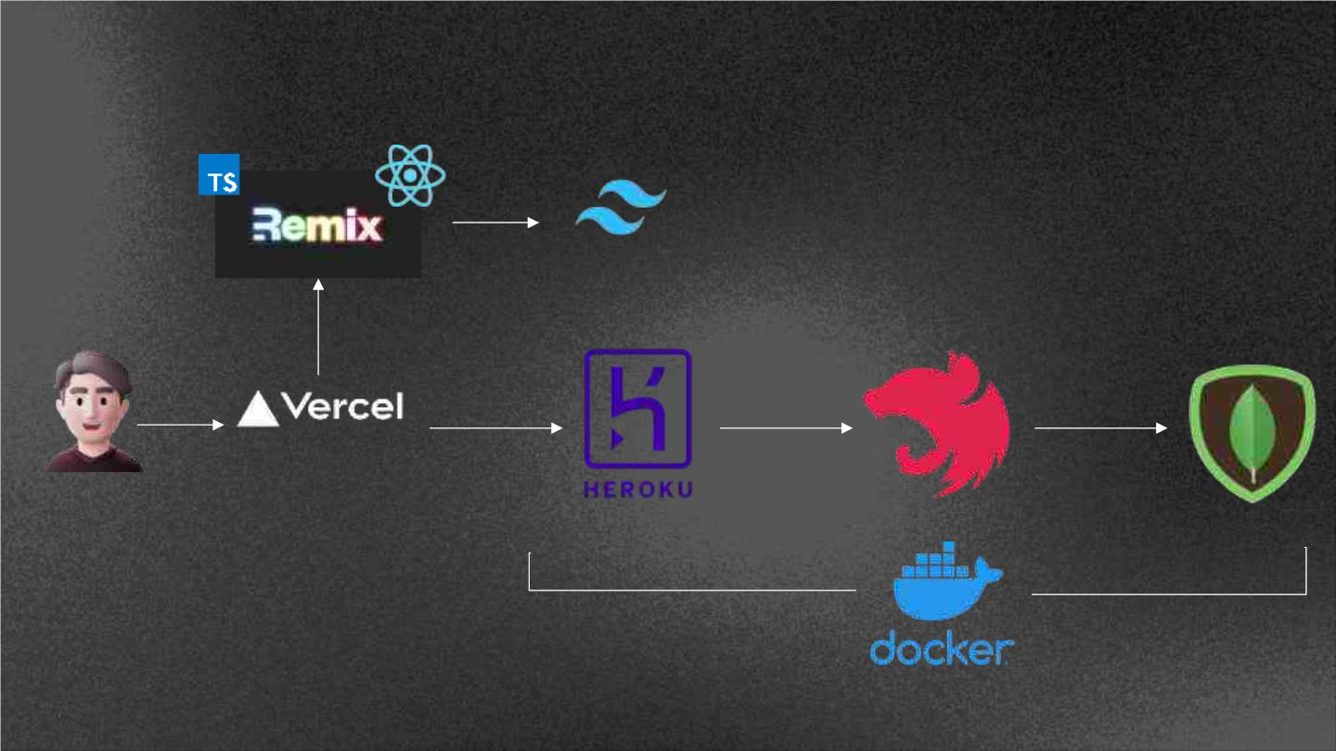
CitiAcademy Tech Stack
TailWind CSS
Component Builder
Front End Server
User
Back End Server
Environment Deployment

Slide 17

Thank You
Team FizzBuzz
HackOverFlow 2022

